Slide 1
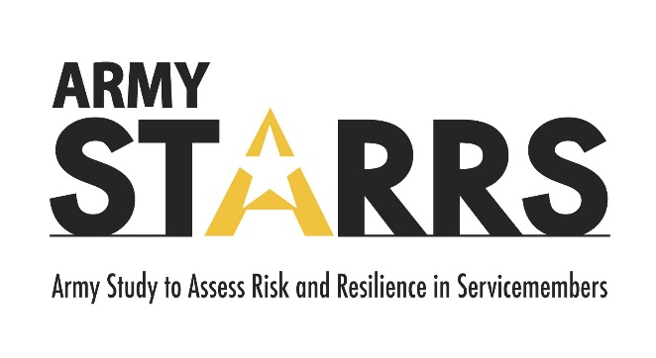
Army Study to Assess Risk and Resilience in Servicemembers
(Army STARRS) and
Study to Assess Risk and Resilience in Servicemembers – Longitudinal Study (STARRS-LS)
Robert J. Ursano, M.D.
Professor of Psychiatry and Neuroscience
Director: Center for the Study of Traumatic Stress
Uniformed Services University of the Health Sciences
Bethesda, MD USA

Slide 2
Disclaimer
The opinions and assertions expressed herein are those of the author(s) and do not reflect the official policy or position of the Uniformed Services University of the Health Sciences or the Department
of Defense.

Slide 3
Why Was STARRS Needed?
Starting in 2004, there was a rapid & persistent rise in the Army suicide rate.
In 2009, something unusual happened: the suicide rate in the Active Duty Army exceeded the rate in the demographically-adjusted civilian population.

Slide 4
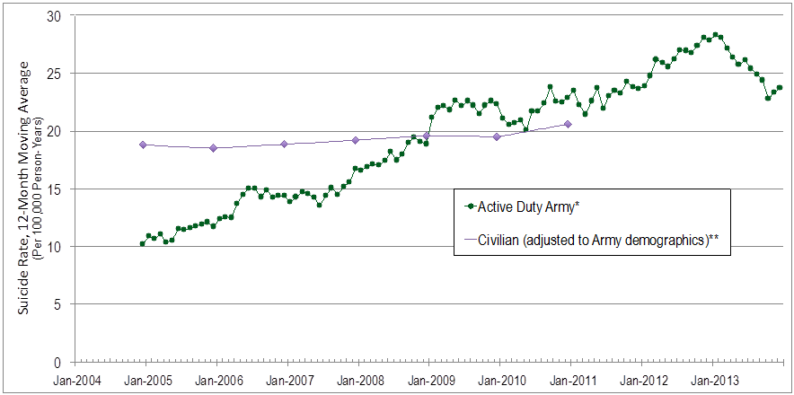
Suicide Trends: Active Duty Army & Matched Civilians
* Crude suicide rates, using data from Army STARRS (2004-2009) and Army Active Duty Strength reports (2010-2013)
** Civilian data from Centers for Disease Control, adjusted by Army STARRS to 2004 Army distribution of age, sex and race/ethnicity

Slide 5
Was it due to the Wars?
The increase in the suicide rate coincided with the wars in Afghanistan and Iraq.
  Operation Enduring Freedom (OEF)
  Operation Iraqi Freedom (OIF)
Some hypothesized the increase was simply due to the wars.

Slide 6
Active Duty Army Suicide Rates by Deployment Status
Source: Army STARRS calculations

Slide 7
What Was Needed?
To address this complicated problem, the Army needed research that was sufficiently:
large (suicide is a rare event)
creative (using state-of-the-art methodologies)
comprehensive (attack problem from multiple angles)
The Army approached NIMH to find academic scientists with the expertise and experience to design and conduct an independent research program to investigate the problem.

Slide 8
Competitively Awarded Grant
NIMH issued a request for grant applications to design & implement the necessary research
The winning submission was from a consortium of multi-disciplinary investigators at the Uniformed Services University (USU); the University of California, San Diego (UCSD); Harvard Medical School (HMS); and the University of Michigan (UM)
                Robert J. Ursano, MD (USU): PI
                Murray B. Stein, MD, MPH (UCSD): Co-PI
                Ronald C. Kessler, PhD (Harvard): Site PI
                Steve Heeringa, PhD then James Wagner, PhD (UM): Site PI

Slide 9
Goals of Army STARRS
(2009-2015)
To identify risk & protective factors for suicide & suicide-related behavior for the Army to use to revise existing risk reduction programs & efforts and/or develop new risk reduction programs.
To deliver “actionable” findings to the Army rapidly (during the course of the research; not wait until the end)
To establish Army cohorts for future follow-up studies & continued benefit to the Army & DoD

Slide 10
Design of Army STARRS
Not a single study
Integrated multi-study design
Involves 8 separate but integrated epidemiologic studies (incl. cross-sectional, historical cohort, prospective cohort, case-control, methodologic & neurobiologic studies) to comprehensively & creatively investigate risk factors & protective factors for:
  Suicide
  Suicide-related behavior
  Related mental & behavioral health

Slide 11
  Army STARRS:
  8 Component Studies
1 | Historical Admin. Data Study (HADS) | >1.6 million active duty Soldiers from 2004 to 2009 Integrated >1.1 billion de-identified records (from 38 Army/DoD sources)
2 | New Soldier Study (NSS) | 57,269 Soldiers attended survey sessions (at 3 sites) 35,002 Soldiers provided a blood sample
3a | All Army Study (AAS) | 34,633 Soldiers attended survey sessions (>50 sites CONUS & OCONUS)
3b | AAS In-Theater (in Kuwait) | “Outbound” & “inbound” Soldiers during R&R processing in Kuwait 10,255 Soldiers attended survey sessions
4 | SHOS-A (case-control) | Interviewed in-patient suicide attempters (cases) at 5 sites & controls 561 Soldiers enrolled (186 cases, 375 controls) & 296 blood samples
5 | SHOS-B (case-control) | Interviewed Army supervisors & next-of-kin of suicide cases & controls 603 interviews completed for 150 cases & 276 controls
6 | Pre/Post Deployment Study (PPDS) | Longitudinal study with 4 waves of data collection (4 time-points) at 3 sites 1 mo pre-deployment (T0): 9,488 Soldiers participated; 8,090 gave blood 1 mo post-deployment (T1): 10,116 Soldiers participated; 8,822 gave blood 3 mos post-deployment (T2): 9,193 Soldiers participated 9 mos post-deployment (T3): 6,977 Soldiers participated
7 | Criminal Investigation Division Study (CID) | Systematic review & abstraction of Army death reports from 2005 to 2009 Reviewed, abstracted, thematically-coded 1,311 CID case files
8 | Clinical Reappraisal Study (CRS) | To calibrate clinical survey measures used in AAS and NSS Conducted clinical interviews with 460 Soldiers

Slide 12
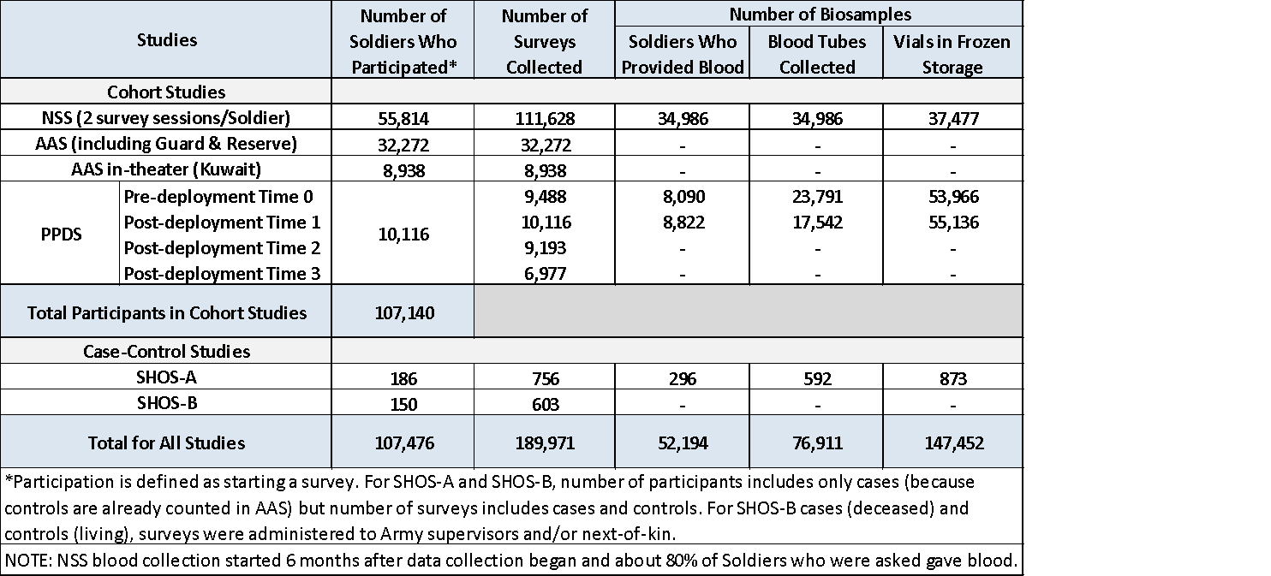
Army STARRS Data Collection Summary: Soldiers, Surveys, Biosamples
For Studies with Data Collection from Soldiers
(HADS, CID, CRS not included)

Slide 13
Army STARRS:
Data Collection Timeline
Year 1 |  |  |  | Year 2 |  |  |  | Year 3 |  |  |  |  | Year 4 |  |  |  | Year 5
July 2009-June 2010 |  |  |  | July 2010-June 2011 |  |  |  | July 2011-June 2012 |  |  |  |  | July 2012-June 2013 |  |  |  | July 2013-June 2014
Q1 | Q2 | Q3 | Q4 | Q1 | Q2 | Q3 | Q4 | Q1 | Q2 |  | Q3 | Q4 | Q1 | Q2 | Q3 | Q4 | Q1 | Q2 | Q3 | Q4
Design, Develop, Pre-Test
 |  | Research Data Enclave and Historical Administrative Data Study (HADS)
 |  |  |  |  |  | New Soldier Study (NSS)
 |  |  |  |  |  | All Army Study (AAS)
 |  |  |  |  |  |  |  |  |  |  | C R S
 |  |  |  |  |  |  |  |  | Soldier Health Outcomes Study A (SHOS-A)
 |  |  |  |  |  |  |  |  |  | Soldier Health Outcomes Study B (SHOS-B)
 |  |  |  |  |  |  |  |  | PPDS T0
 |  |  |  |  |  |  |  |  |  |  |  |  | PPDS T1
 |  |  |  |  |  |  |  |  |  |  |  |  |  | PPDS T2
 |  |  |  |  |  |  |  |  |  |  |  |  |  |  |  |  | PPDS T3

Slide 14
Study to Assess Risk and Resilience in Servicemembers – Longitudinal Study (STARRS-LS)
Continuation of the Army Study to Assess Risk and Resilience in Servicemembers (Army STARRS)
2015 to present

Slide 15
STARRS-LS: 3 Cohorts being followed across time
~3 million in expanded HADS cohort: total Army 2004-2019
  Following with many Army/DoD datasets including National Death Index (NDI)
~72K in STARRS cohort (subset of above)
  Army STARRS survey data (NSS 2011-2012, AAS 2011-2013, PPDS 2011-2014)
  Army/DoD admin data thru 2019 linked to survey data
  NDI data (currently thru 2020) with date of death & all causes of death
  Research Team will continue requesting updated NDI data from CDC annually
~14.5K in STARRS cohort sample (subset of STARRS cohort)
  Army STARRS survey data (NSS 2011-2012, AAS 2011-2013, PPDS 2011-2014)
  STARRS-LS follow-up survey data: Wave 1 (2016-2017), Wave 2 (2018-2019), Wave 3 (2020-2022)
  Army/DoD admin data thru 2019 linked to survey data
  NDI data thru 2020 with date of death & all causes of death (will update annually)
  Wave 4 follow-up survey data collection in-progress (2022-2024)

Slide 16
STARRS-LS:
Diagram of Cohorts

Slide 17
Progress Analyzing Data &
Producing Findings
Research Team continues to be highly productive at analyzing data, producing potentially actionable findings & writing-up the findings
A total of 128 studies published, accepted, or submitted
    122 studies published
    2 studies accepted for publication (in-press)
    4 studies submitted for publication (waiting for decision)
    Summary of published studies: https://www.cstsonline.org/whats-new/wn-armystarrs

Slide 18
STARRS Family of Studies
(and Studies Based on STARRS Public Data)
STARRS Funded:
  Army STARRS studies: baseline - analysis ongoing
  STARRS-LS studies: continuation & new follow-up surveys
    Waves 1 & 2 - data collection completed; analysis ongoing
    Waves 3 & 4 - Wave 3 data collection underway; Wave 4 planned
Non-STARRS Funded (collaborations using STARRS data):
  Sexual trauma study (Harvard) - completed
  Workplace violence study (Harvard) - completed
  SOF collaboration (USU & SOCOM) - completed
  GWAS of risk tolerance & risky behaviors (UCSD & SSGAC) - completed
  PTSD & sleep disorders study (USU & WRNMMC) - ongoing
  Whole genome sequencing studies (USU APG Dept.) - ongoing
  PTSD genetic studies (UCSD & NIMH-PGC) - ongoing
  Other genetic & epigenetic studies (UCSD) - ongoing
  Firearms behavioral practices & suicide risk (USU & CDC) – ongoing
  (Non Family Members: Studies by 49 approved users of STARRS public data at ICPSR)

Slide 19
Suicide Rates
(Enlisted Regular Army, 2004-2009)
Gilman, et al. Psychological Medicine, 2014

Slide 20
Suicide Attempt Rates
(Enlisted Regular Army, 2004-2009)
Ursano, et al. JAMA Psychiatry, 2016

Slide 21
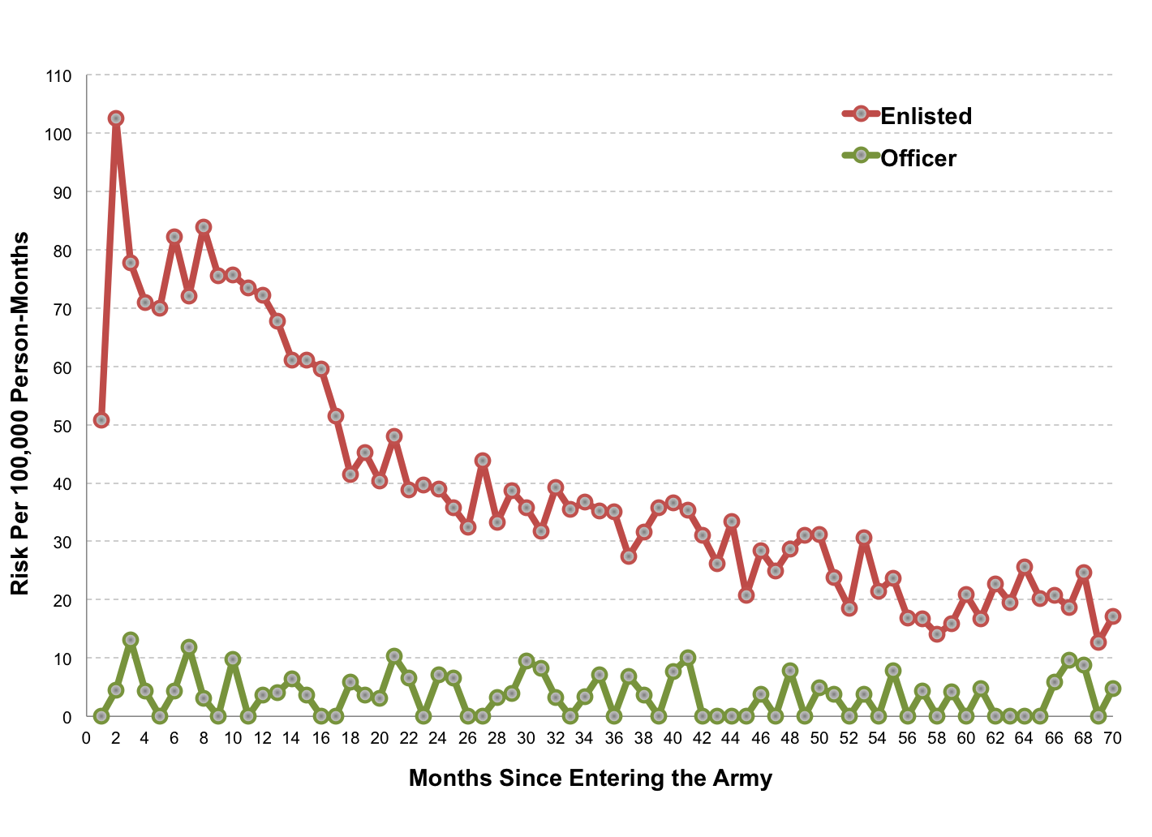
WHEN:…Suicide Attempt Risk by
Time in Service
(HADS 2004-2009)
Ursano et al. (2015). JAMA Psychiatry

Slide 22
Hay Stacks…

Slide 23
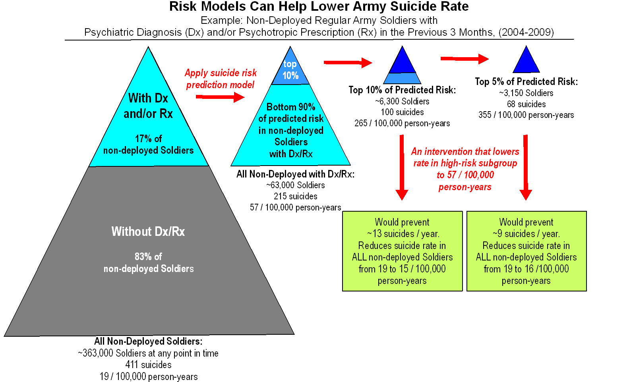
Concentration of Risk

Slide 24
WHO:…Suicide Attempt (S.A.) Risk: Combat Arms, Special Forces & Combat Medics (HADS 2004-2009)
Overall: Combat Arms & Combat Medics had higher odds of S.A. (1.2, 1.4), & Special Forces had lower odds (0.3), than other MOSs. MOS associated with S.A. in first 10 years of service, but not beyond.
First year of service: Combat Medics had higher odds of S.A. than Combat Arms & other occupations.
Deployment: Combat Arms & Combat Medics had higher odds of S.A. than other occupations among those never deployed and those previously deployed. Combat Medics also had higher odds of S.A. among deployed.
Military occupation can inform the understanding of S.A. risk.
Ursano, et al. (2017) BMC Psychiatry

Slide 25
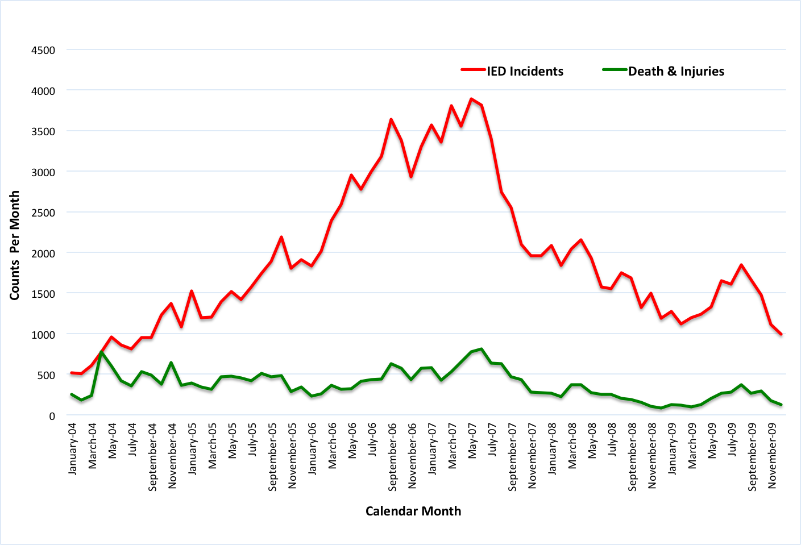
Frequency of IEDs & Suicide Attempts (HADS 2004-2009)
BLUF: Threat of new weapons may increase stress burden as measured by suicide attempt rate among Soldiers. Targeting risk perception & perceived preparedness, particularly early in a Soldier’s career, may improve psychological resilience & reduce suicide risk.
Examined association of monthly IED rates with suicide attempt risk in deployed & non-deployed for all active duty Regular Army suicide attempters (n=9,791) & equal-probability sample of control person-months (n=183,826).
Soldiers’ suicide attempt risk increased with increasing numbers of IEDs.
Suicide attempt was 26% more likely for each 1,000 IED increase in monthly frequency.
Association of IED frequency with suicide attempt was greater for Soldiers in first 2 years of service than for those with 3+ years of service.
Among Soldiers in 1st two years of service, association was constant for all 3 deployment statuses.
Among Soldiers with 3+ years of service, association was higher for those never deployed & currently deployed, than for those previously deployed.
Ursano, et al. (2017) Military Med

Slide 26
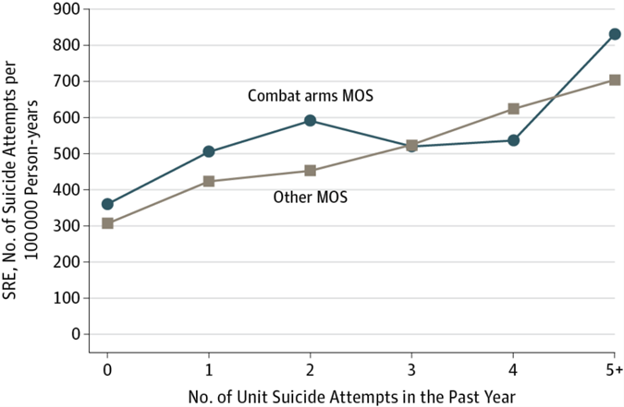
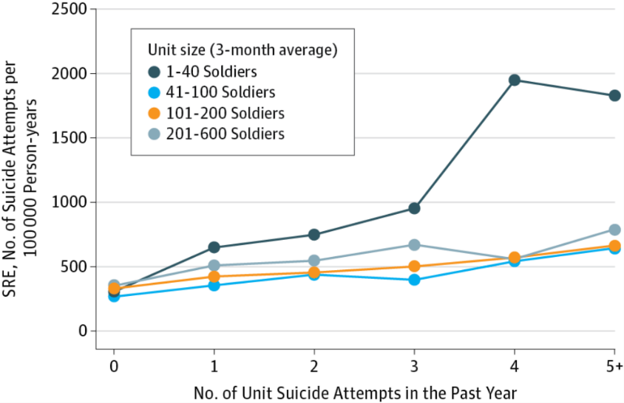
Risk of Suicide Attempt (SA) among Soldiers in Army Units with a History of Suicide Attempts (HADS 2004-2009)
SA risk increased if 1 S.A. in unit in past yr
Odds increased with # of SAs in unit (OR=1.4 with 1 SA; OR=2.3 with 5+ SAs)
Association true in combat arms & other MOS
Highest risk in small units (1-40 Soldiers)
If risk reduced to 0 SAs in unit in past yr, number of SAs would decrease 18.2%
Conclusion:
Units with a history of SAs are important targets for preventive interventions
Study included all SAs in enlisted Regular Army Soldiers 2004-2009 (n=9,650) and an equal-probability sample of control person-months (n=153,528)
Ursano, et al. (2017) JAMA Psychiatry

Slide 27
Documented Family Violence (FV) and Risk of Suicide Attempt
(HADS 2004-2009)
Active duty Regular Army enlisted Soldiers (n=9,650 with medically documented SA; n=153,528 control person-months)
Odds of SA were higher for those with a FV history
Odds increased as number of FV events increased
Past-month FV had SA odds ~5 times higher than those with no FV history
SA odds elevated for both perpetrators and victims
For males, higher SA risk in perpetrators than victims
For females, SA risk did not differ between perpetrators & victims
SA risk highest in initial months after 1st FV event
Conclusion: FV is an important consideration in understanding risk of SA among Soldiers
Ursano, et al. (2017) Psychiatry Research

